Slide 1
e-Procurement Experiences
in Korea
Oct. 2014
Kang-il Seo
Deputy Director, International Cooperation Division
Public Procurement Service, Korea

Slide 2
Public Procurement in Korea
Korea’s Public Procurement Process
PR (mandatory)
PR (optional)
Centralized procurement through PPS (2013) : USD 37.9 B
- 33.5% of Korea’s public procurement (113 B)
Transaction via KONEPS : USD 73 B (64%) of Korea’s public procurement
However, 100% of tender notices are published through KONEPS

Slide 3
e-Procurement in Korea
KONEPS (Korea On-line E-Procurement System)

Slide 4
e-Procurement in Korea
KONEPS (Korea On-line E-Procurement System)
Single window for public procurement
End-to-end service that covers the entire procurement processes
Seamless service through data interconnection with 156 database systems
“KONEPS”
Korea
ON-line
E-Procurement
System
e-Bidding
e-Contracting
e-Payment
Online
Shopping
Mall
e-Ordering

Slide 5
e-Transformation – Before & After
Seamless Service through Data Integration
Data interchange with 144 external info systems for seamless process
Before
Ministry of Strategy
and Finance
Public Buyer
Industry
Associations
Bid
Supplier
National Tax Office
Surety Companies
Construction
Authorities
Credit Rating Companies
Certification-
Related agencies

Slide 6
e-Transformation – Before & After
Seamless Service through Data Integration
Data interchange with 144 external info systems for seamless process
After
Contract
Delivery
Ministry of Strategy
and Finance
Industry
Associations
Public Buyer
National
Tax Office
KONEPS
Credit Rating
Company
Construction
Authorities
Surety
Companies
e-Bid
Korea Financial
Telecommunications
& Clearings Institute
Certification-
Related agencies
Supplier

Slide 7
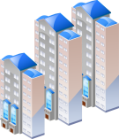
KONEPS at a Glance
Certification
-Related Agencies
PPS
Operation
Use
Linkage
Ministry of Security & Public Administration
Public
Organizations
(Buyers)
Linkage
Construction
-Related Associations
Private
Businesses
(Suppliers)
Ministry of
Strategy
and Finance
Surety Companies
Construction
CALS
Korea Financial Telecommunications
&Clearings Institute

Slide 8
e-Procurement in Korea
KONEPS Online Shopping Mall
e-Ordering through KONEPS Online Shopping Mall
Framework contracts (unit-price based) for frequently purchased commercial products
Contracted by PPS, available for all public entities for e-ordering
In 2013, public purchase from KONEPS Online Shopping Mall amounted to USD 13.9B
10
Notes:
I will present another example.
Earlier in my presentation, I briefly introduced Korea’s MAS contracts.
These are framework contracts for frequently purchased commercial products.
For these types of products, PPS negotiates with suppliers and establishes unit-price contracts.
Once the contract is made, contracted products are registered in KONEPS Online Shopping Mall,
and public entities can directly place online orders.
PPS uses this contracting method is used as a way to achieve economy of scale.
Because MAS contracts opens broad opportunities to sell to all public entities,
Suppliers tend to offer favorable price terms.

Slide 9
Facts and Figures
KONEPS’s transaction volume in 2013 : $74 B of Korea’s public procurement ($113 B)
Users
46,996 public entities
269,862 businesses
e-Bidding
23.4M bidders in 280K e-bidding
Transaction volume : $45.5 B
e-Contracting
& e-Payment
785K e-Contracts and e-Payment
Online
Shopping mall
Transaction volume : $13.9 B
Notes:
KONEPS의 활용에 따른 2012년 주요 실적들입니다.
한국 정부 전체 조달규모의 약 63%가 KONEPS를 통해서 집행되었습니다.
올해 상반기까지 KONEPS에 45,914개 공공기관이, 257,253개 기업이 사용자로 등록하였습니다.
전자입찰은 29만 건이 집행되어 2천만개 기업이 입찰에 참가하였습니다.
자주 사용하는 물품을 사전에 단가계약 한 후, 필요한 공공기관이 필요한 때에 손 쉽게 바로 구매할 수 있도록
지원하는 online shopping mall도 활성화되어, 120억달러 규모가 거래되었습니다.

Slide 10
KONEPS - Implementation and Evolution
e-Procurement as Part of Broader e-Government Project
e-Government
Innovation in Services
Administrative Productivity
1
Government-wide e-Procurement System
5
National Finance system
Integrated Administration System for Local Governments
2
Single Window for Civil Services
6
7
Nation-wide Educational Administration System
3
Integrated Social Security Information System
Standardized HR Management System
8
4
Internet-based National Taxation System
9
Consolidation of e-Document Exchange and e-Reporting
INFRASTRUCTURE
10
e-Authentication and e-Signature System
11
Government-wide IT-governance Environment

Slide 11
Effect of e-Procurement
Increased Transparency
Real-time information disclosure
Bidding results and contract details disclosed to the public on-line
Peer monitoring on fair results
Accuracy in bid evaluation
Bid evaluation based on validated data
Support for decision-making
Traceable prices and specifications
Purchase history and price trend information

Slide 12
Open Procedure : Pre-tender Phase
Disclosure of Preliminary Notice of Tender
Upon receiving a procurement request, PPS conducts :
Review on bidder eligibility and draft specification
Publish a preliminary tender notice online for 5 days (7 days for service tenders)
PPS Review
Bidder eligibility,
Draft Spec.
Disclosure of Preliminary Tender Notice
Businesses
Feedback on eligibility and spec.
PPS / End-user Entity
Tender modification
(if needed)
Tender Notice
Potential bidders have the chance to challenge the tender conditions (specifications and bidder eligibility, etc.) before the official tender notice
Contracting officials are responsible to respond
Both challenges and responses are open to public (online)
* Note : for tenders below USD100,000, preliminary tender notice is not required
Notes:
This slide shows the procurement process for centralized procurement and decentralized procurement.
The blue area is the centralized procurement.
It includes mandatory procurement requests from central government entities,
and voluntary procurement requests from local governments and public enterprises.
The green area is decentralized procurement,
in cases where local government and public enterprises choose to make procurement themselves.
For both cases, the procurement is facilitated by KONEPS, the national e-Procurement system.
In 2011, centralized procurement through PPS was 34 billion US dollars, covering 34% of Korea’s total public procurement.
Of this, about 53% was upon mandatory procurement requests and 47% was upon non-mandatory procurement requests.

Slide 13
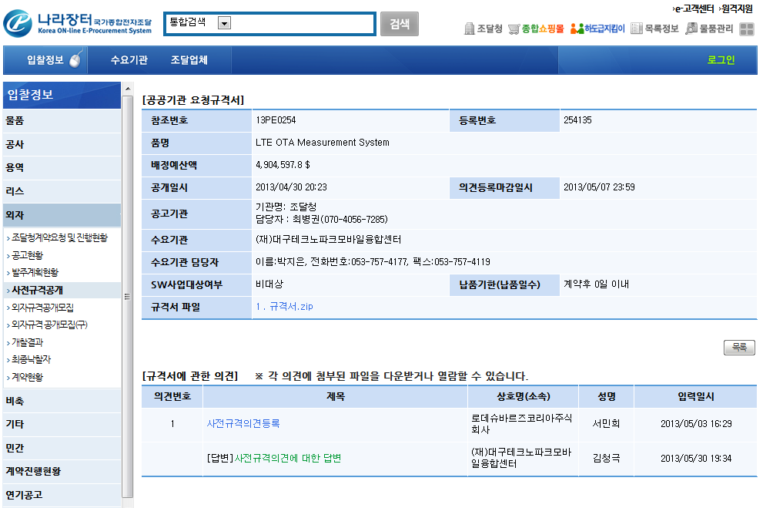
Open Procedure : Pre-tender Phase
Disclosure of Preliminary Notice of Tender : the Practice
The national public procurement portal at www.koneps.go.kr
Challenge Deadline
Contracting Official’s contact
Preliminary Tender Notice
Challenge from a Firm
Response from Contracting Officer

Slide 14
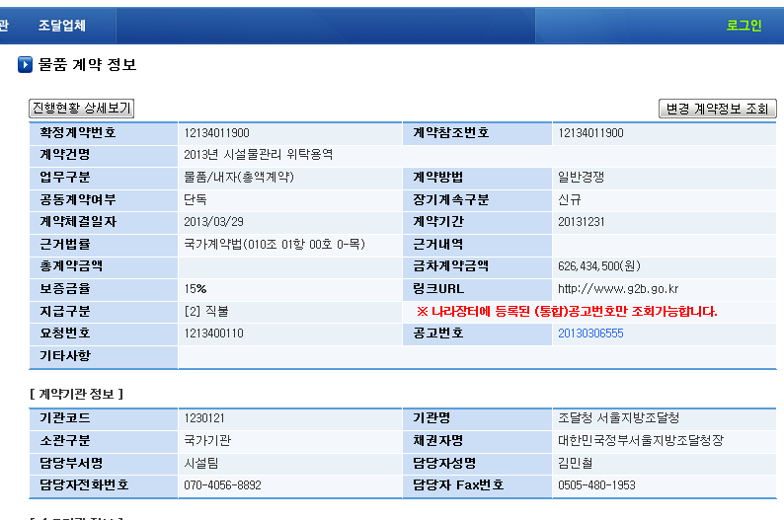
Information Disclosure
Contract Details
Full Progress Report
Contract Info
Contract Modification Report
Contract #
Reference #
Contract Name
Category
Competition Method
Single / Consortium
Single / Extended
Contract Date
Contract Period
Governing Law
Total Contr. Price
Contr. Price
Performance Bond
URL
Payment Method
PR #
Tender #
Remarks
Contracting Agency Info
Agency Code
Agency Name
Agency Type
Representative
Contracting Unit
Contracting Officer
Contact
Fax

Slide 15
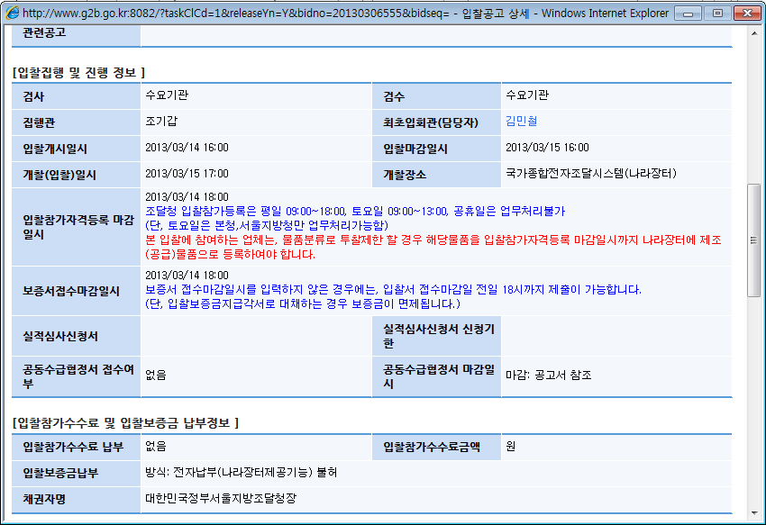
Information Disclosure
Bidding Details
Bidding Info
Inspection
Acceptance
Senior Mgt. Official
Contracting Official
Bidding Start Date
Bidding End Date
Bid Opening
Bid Opening Place
Last Date for Bidder Registration
Bid bond deposit deadline
Request for Past Expr. Assessment
Deadline for Request
Consortium Application
Consortium Application Closure
Bid bond / bidding fee Info
Bid bond
Bidding fee
Bid bond method
Payable to

Slide 16
Information Disclosure
Bidding Results

Slide 17
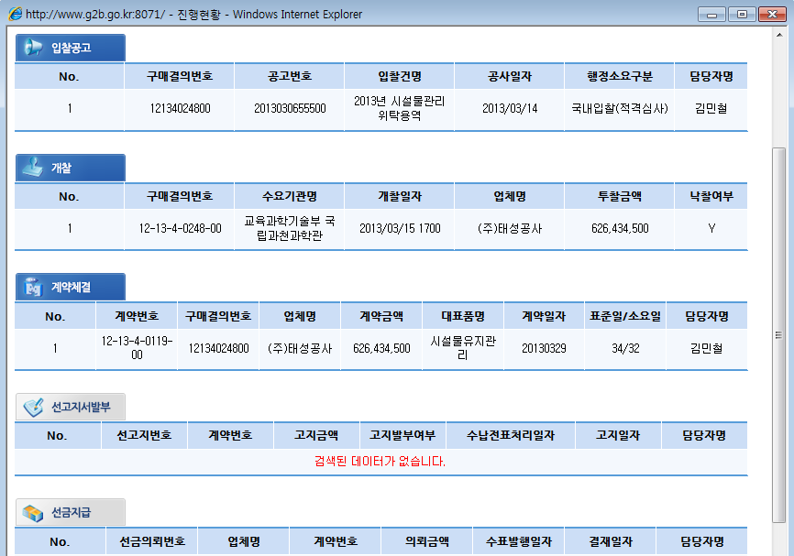
Information Disclosure
Progress Report
Tender Notice
Purchase #
Tender #
Tender Name
Date
Compt. Type
Contr.
Official
Awarding
Purchase #
Procuring Entity
Bid Opening
Nominee
Price
Award
Contracting
Contr. #
Purchase #
Contractor
Price
Item
Date
Process time (days)
Standard / Actual
Contr. Official
Upfront Payment Request
Upfront Payment

Slide 18
Effect of e-Procurement
Saving of Transaction Costs via KONEPS
Cost saving : USD 8 B per year
Private Sector : USD 6.6 B
Public Sector : USD 1.4 B
Transaction Cost Saving
- Reduced visits
- Reduced labor costs
$ 6.6 B
Increased efficiency
Receiving bids, validating related docs.
and selecting the winning bid
Reduction of 7.8 million pages of paper documents per year
Before | over 30 hrs
After | less than 30 mins.
- Reduced lead-time
- Streamlined Process
$ 1.4 B
Public Sector
Private Sector

Slide 19
Way Forward
e-GP : the Next Generation
Business
Intelligence
e-Ordering
e-Bidding
Consolidated
GP Data
Subcontract
Mgt. System
Platform shared with private sector
Consolidated public sector procurement data
- Value-added data for policy makers
Better Monitoring on Subcontracting
Register subcontracts
Pay directly to subcontractors
Issue certificates
Open API
- Value-added data for businesses

Slide 20
THANK YOU
Notes:
제 발표를 경청해 주셔서 감사드립니다.

Slide 21
Appendix I

Slide 22
Business Process Reengineering
Redesigning Procurement Work Process for Improvement
80% of the total 565 processes in three categories (goods, services, construction works) were revised
152 processes were removed, and over 300 processes were streamlined through integration and digitalization
Standardization of e-Document forms and contents
Foundation for standardized product catalogue system
(product classification / identification)
Determining standard e-Document forms (eb-XML based standards with development guidelines)
Revision of Legal and Institutional Basis
Provisions for the registration of information and mandatory reporting for e-Procurement services
Revisions for the streamlining of procurement procedures

Slide 23
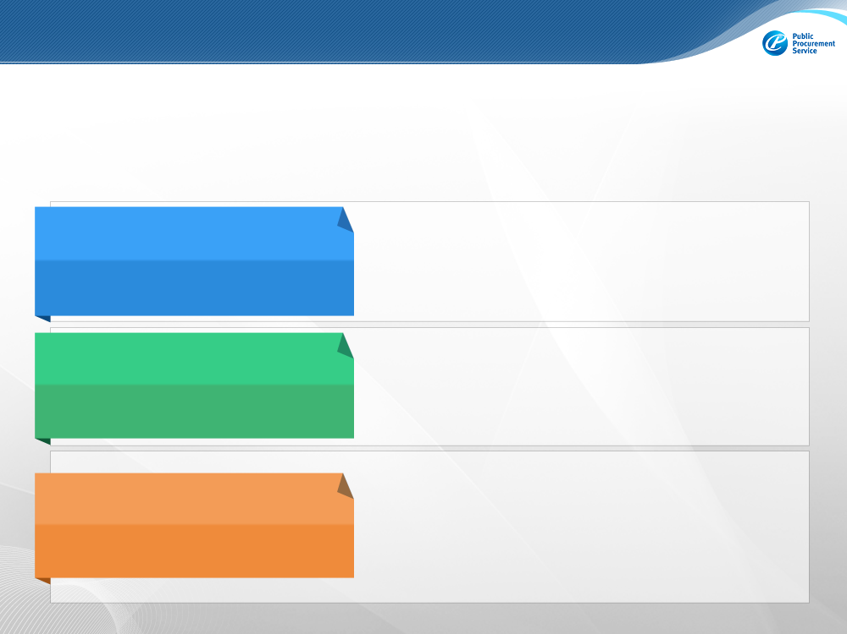
Revision of Laws and Regulations
Act on Contracts to Which the State is a Party is the statutory law that governs government Procurement, but e-GP is not incorporated in the Act.
e-GP is regulated at a lower level, by an enforcement decree and regulations
Act on Contracts to Which the State is a Party
(State Contract Act)
General guideline on bidding and contracting for the central government : method of contracting and awarding
No provisions on e-GP
Enforcement Decree of State Contract Act
(presidential decree)
Mandates the publication of tender notice, procurement reporting, and announcement of debarments via designated e-GP system (KONEPS)*
Empowers the Minister of Ministry of Strategy & finance to designate the operator of the e-GP system
Act on the Use and Promotion of e-Procurement
(effective as of Sept. 2013)
Urges on the use of e-Procurement whenever possible, including e-bidding and e-contracting
* Enforcement Decree of Local Government Contract Act provides for same obligations for local governments.

Slide 24
Revision of Laws and Regulations
Framework Act on Electronic Commerce
Ministry of Knowledge & Economy
Established in 1999/ revised in 2002, 2005, 2007
Provides for legally binding effect for digital documents
Digital Signature Act
Ministry of Public Administration and Security (MOPAS)
Established in 1999/ revised in 2001, 2005
Legal force clarification for a digital signature
Revision of Relevant Regulations
Mandatory: tender notice via KONEPS, sanctions against fraudulent bidders, disclosure of award information
Optional: use of e-Bidding and e-Contracting
Grace period (3 months) and interim measures for smooth transition

Slide 25
Data Interchange Links
1
Other
Bidding System
Credit Certificate
Authorities
Document Send/Receive Type
Using the standard linkage solution of KONEPS, procurement information is sent and received in real time or in batches in document format
21
9
Government/
Public Org
Credit Info
Bid, Contract Info
Supplier
Registration Info
28
Tax calculation sheet,
Billing statement,
Order sheet
41
2
Contract,
Invitation tender
Catalog Info.
Inquiry Service Type
Product Quality
Certificate Authorities
Only the information requested by an entity is provided in XML format in real time
Quality Certified Info
Standard Linkage
System
Catalog Info
12
guarantee
3
Surety
Company
Bid, Contract Info
Housing bond, development bond, network Loan
Bank
Relay Type
19
Pre-performed result
Certified Info
15
Document relay is mediated through KONEPS between procurement info company and supplier
Contract Info
Related
Associations
Certificate
Authorities
12
5
Notes:
KONEPS는 현재 162개 기관 시스템과 연계되어있습니다.
KONEPS의 연계형태는 크게 3가지로 나뉘어집니다.
먼저 문서송수신 방식입니다.
조달정보는 그 문서의 진위나 발생시점 등에 따라 낙찰자가 뒤바뀔 수 있는 매우 중요한 문서입니다.
따라서 조달업무에 사용하는 대부분의 조달정보는 이 문서송수신 방식에 의존하고 있습니다.
문서송수신 방식을 이용하는 연계는 KONEPS가 기본적으로 적용하고 있는
PKI기반의 전자서명과 암호화 알고리즘을 적용합니다.
이 방식은 문서 전송과정의 변조와 문서 행위에 대한 부인방지, 송수신 시점에 대한 시점확인을 가능하게 합니다.
또한, KONEPS는 조달기초정보의 공유를 위해 웹서비스 기반의 조회서비스 방식과 중계방식을 지원하고 있습니다.

Slide 26
Open API for Procurement Information
Main schedule
Provide real-time procurement information of 5 category 91 cases (2013. 12)
Service list
Service category | No. API | Main function
Pre-announcement information | 6 | pre-announcement of specification and suppliers opinion which is performed prior to tender notice
Tender notice | 30 | Tender notice list, detail tender information, etc.
open tender announcement | 15 | Bidders list, estimated price, winners information, bidding price of each bidders, etc.
contract information | 31 | Contract list, detail contract information, etc.
Catalog information | 9 | Item classification information, catalog information, maker’s information, etc.
5 Categories | 91 Services
Notes:
Open-API로 제공되는 정보는 5개 영역의 91개 정보입니다. 이 정보들은 기본적으로 KONEPS에서 조회되어 공개되는 정보들입니다.
하지만, 인터넷상에 공개되는 정보는 사람들이 직접 KONEPS에 접속하여 조회하고 활용해야 하지만, Open-API로 제공되는 정보는 시스템으로 자동 활용이 가능합니다. 많은 민간의 입찰정보 회사들이 이 정보를 이용해 부가적인 서비스를 유료 회원들에게 제공하고 있으며, 모바일 입찰 정보 앱 서비스를 제공하는 회사도 있습니다.

